Slide 1
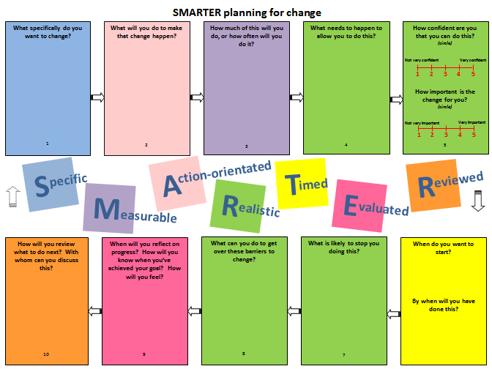
What do you notice about this sheet?
Cyclical nature of goal-setting (arrows)
Colour of each box relates to one letter
Text is all ODQs or Open Questions
More boxes for Realistic – very important
Space to write
Boxes in different order to letters – better flow
How could you use this sheet to make your own plan for change?
How would you use it with others to support them to make their plan for change?

